Slide 1
Fecal Incontinence New Surgical Options
Duc M. Vo, MD
Northwest Surgical Specialists

Slide 2
Disclosures
none

Slide 3
Outline
Definition
Etiologies
Exam findings
Additional testing
Medical management
Surgical options

Slide 4
What is fecal incontinence?
Recurrent inability to voluntarily control the passage of bowel contents through the anal canal
Partial Incontinence
smearing, soiling, uncontrolled flatus
Complete Incontinence
passage of feces without the patient's knowledge, or without voluntary contraction, or both
Notes:
Normal continence depends several factors, mental function, stool volume and consistency, colonic transit, rectal distensibility, anal sphincter function, anorectal sensation, anorectal reflexes

Slide 5
Etiology
Trauma
Surgical (e.g., fistulectomy, fistulotomy, hemorrhoidectomy, sphincterotomy, sphincter stretch, pull-through operations, low anastomoses)
Obstetric
Accidental (e.g., penetrating or avulsion injury, social injury)
Colorectal disease
hemorrhoids, rectal prolapse, inflammatory bowel disease, malignant tumors, radiation
Congenital anomaly
spina bifida, myelomeningocele, imperforate anus, Hirschsprung's disease
Neurologic disease
Cerebral (e.g., tumor, vascular accident, dementia, trauma)
Spinal
Peripheral (e.g., diabetes mellitus, multiple sclerosis, pudendal nerve injury)
Miscellaneous conditions
Laxative abuse, Diarrheal conditions, Fecal impaction, Encopresis
Corman, M. Colon and Rectal Surgery 5th ed

Slide 6
Scoring Systems
Cleveland Clinic Incontinence Score
Incontinence to flatus, liquid or solid stool, wearing a pad, lifestyle alterations
0 (perfect continence)- 20 (complete incontinence)
Fecal Incontinence Quality of Life (FIQL)
29 items considers lifestyle alterations, coping behavior, depression/self-perception, and embarrassment

Slide 7
Epidemiology
prevalence of 0.4–18%
3:1 female/male
Nelson et al, JAMA 1995
Notes:
5.6% in general outpatients, 15.9% in urogynecology patients
A disproportionate fraction of 45–50% of affected individuals have severe physical and/or mental disabilities.

Slide 8
Evaluation
Trauma, obstetric hx, anorectal surgery
Stool frequency, consistency
Colon cancer screening
Perianal exam
Digital exam
Anoscopy
Proctoscopy

Slide 9
Additional Testing
Endoanal ultrasound
Anal manometry
Electromyography
Pudenal nerve terminal motor latency
Defecography

Slide 10
Medical Management
Bowel management program
maintaining optimal fecal consistency, stimulating peristalsis, and controlling the time of evacuation
Fiber (25-30 grams/day)
Stool softeners, constipating medications, laxative, or even stimulant cathartics
Pelvic floor physical therapy-biofeedback
Notes:
Stimulant cathartics – senna, cascara

Slide 11
Surgical Options
Sphincteroplasty
Solesta
Sacral Nerve Stimulation

Slide 12
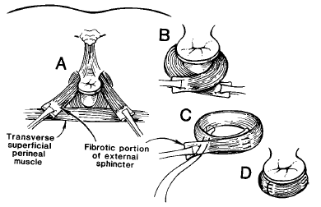
Sphincteroplasty
Fang et al, DCR 1984

Slide 13
Results after Sphincteroplasty
70-80 % success
60% acceptable to excellent 5 year outcomes
50% at 10 years
Gutierrez et al, DCR 2004
Oom et al, DCR 2009

Slide 14
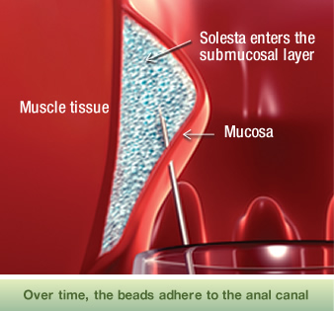
Solesta
FDA approved in 2011
biocompatible bulking agent in an injectable gel
dextranomer microspheres in stabilized hyaluronic acid
4 injections in the submucosal layer of the anal canal

Slide 15
Solesta Results
Randomized sham controlled trial
206 pts (2:1)
52% noted improvement in symptoms (>50% improvement) at 6 and 12months
Compared to 31% in sham group
Graff et al, Lancet 2011
Notes:
Burns no bridges, well tolerated, minimal side effects, outpatient procedure

Slide 16
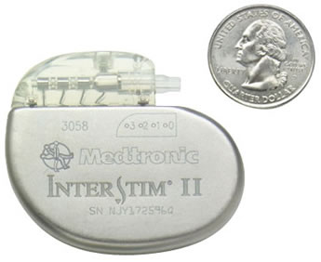
Sacral Nerve Stimulation
Implantable system sends electrical pulses near the 3rd sacral nerve to modulate the neural activity
Influences the behavior of the pelvic floor, lower urinary track, urinary and anal sphincters, and colon.
FDA approve in 2011

Slide 17
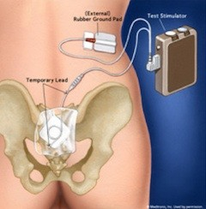
Interstim
3-7 days test phase
Partial implant
Full implant

Slide 18
Sacral Nerve Stimulation Results
Systematic review 41-75% complete fecal continence, 75-100% improvement of episodes of incontinence
5 year follow up of 67 patients, > 50% improvement in 89%, and 36% complete continence, 35% required revision, replacement, or explant.
Jarrett et al, Br J Surg 2004
Tull et al, DCR 2013

Slide 19
Algorithm
Treat associated conditions
Sphincter Injury- sphincteroplasty
Conservative management
Bowel regimen, biofeedback
Mildly patulous anus- Solesta
Poor sphincter function- Sacral Nerve Stimulator

Slide 20
Conclusion
Awareness of the prevalence of fecal incontinence
Screening is important
Fecal incontinence is treatable

Slide 21
For more information contact
Duc M. Vo, MD
Northwest Surgical Specialists
3355 Riverbend Dr.
Suite 300
Springfield, OR 97477
541-868-9303
www.nwsurgicalspecialists.com

